Slide 1



LEVEL 2: Natural Language Processing and Large Language Models
Day 5
Notes:
1

Slide 2
Course Outline
Natural Language Processing
NLP Applications
NLP Pipeline
Text Preprocessing
Text Representation
Recurrent Neural Network
Transformers
Large Language Models
SOTA of Larg Language Models
2
Notes:
2

Slide 3
Learning Objectives
Explain core concepts of Natural Language Processing (NLP) and identify real-world NLP applications.
Describe and implement the NLP pipeline, including text preprocessing and normalization techniques.
Apply text representation methods such as Bag-of-Words, TF-IDF, and word embeddings.
Understand sequence modeling with Recurrent Neural Networks (RNNs) and their limitations.
Explain the Transformer architecture and its advantages over recurrent models.
Analyze Large Language Models (LLMs) and their training paradigms.
Evaluate State-of-the-Art (SOTA) Large Language Models and understand their impact on modern NLP tasks.
3
Notes:
2

Slide 4
Natural Language Processing
4

Slide 5


Natural Language Processing
Language is the primary way humans express ideas, emotions, and intentions
5

Slide 6
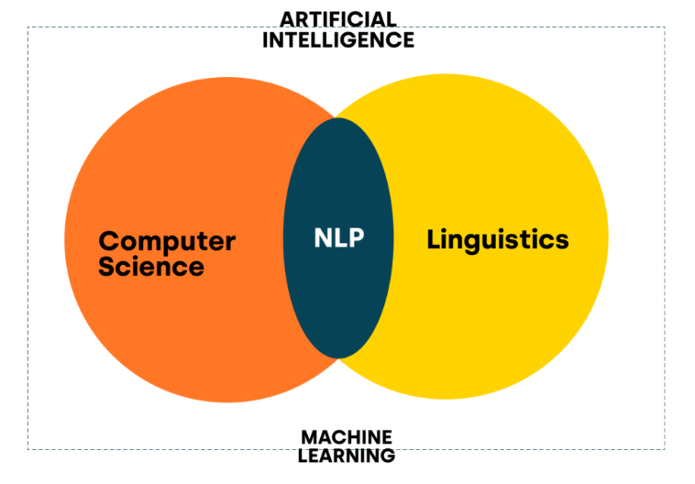
Natural Language Processing
Natural Language Processing (NLP) is a field of Artificial Intelligence that enables computers to understand, interpret, and generate human language in both text and speech form.
6

Slide 7
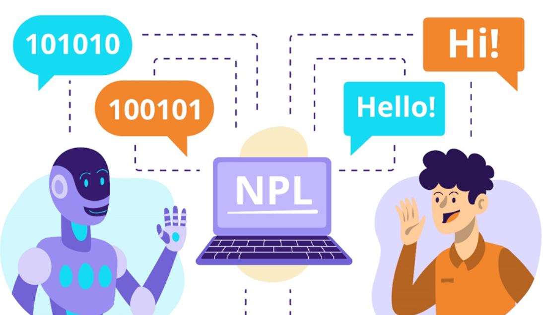
NLP Applications
Virtual assistants
7

Slide 8
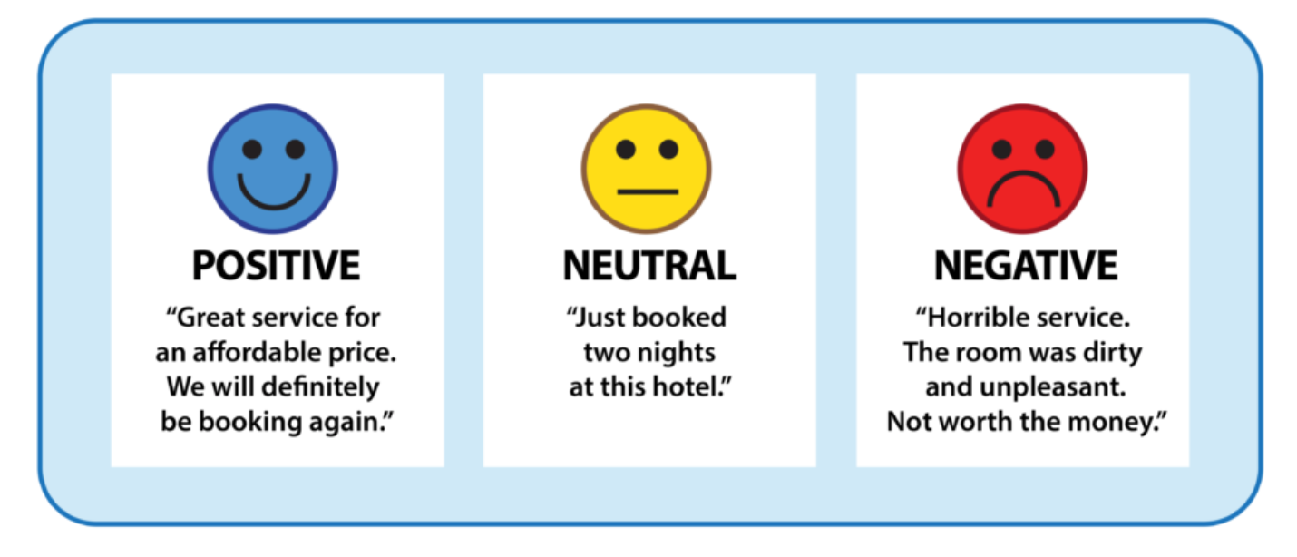
NLP Applications
Sentiment Analysis
8

Slide 9
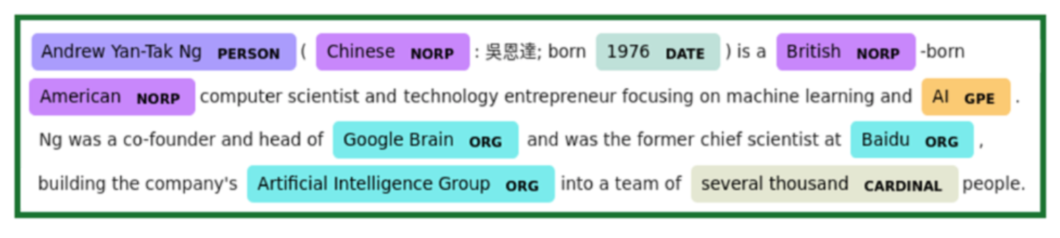
NLP Applications
Named Entity Recognition
9

Slide 10
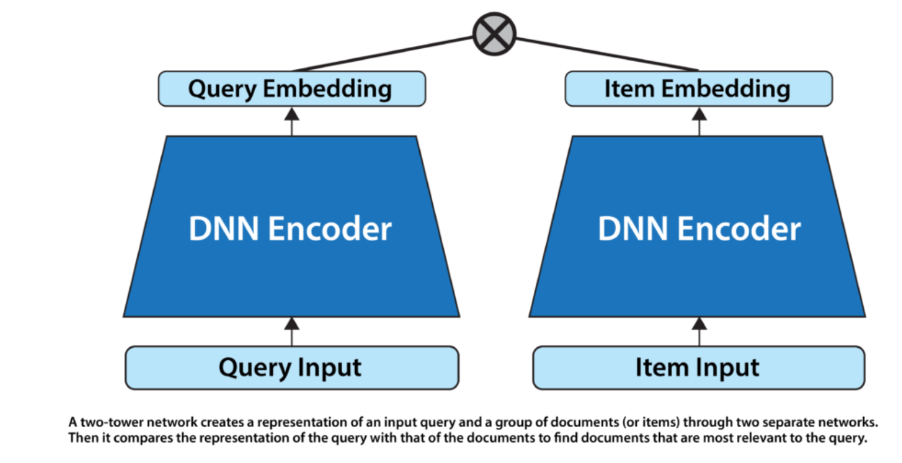
NLP Applications
Information Retrieval
10

Slide 11
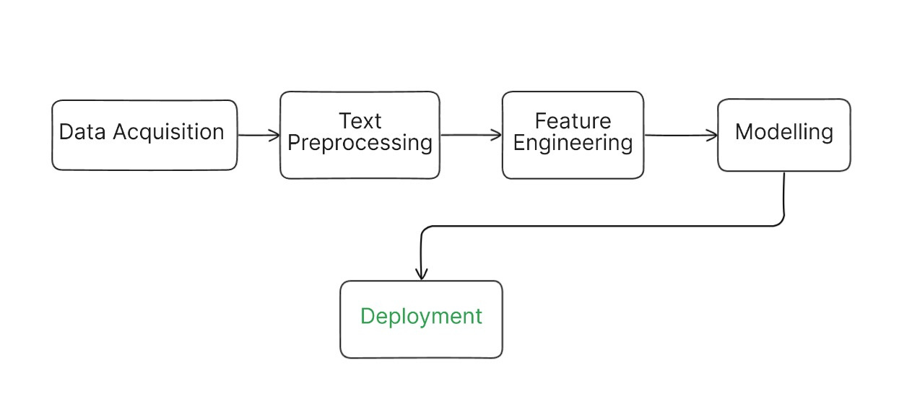
Natural Language Processing
NLP Pipeline
11

Slide 12
Text Preprocessing
12

Slide 13
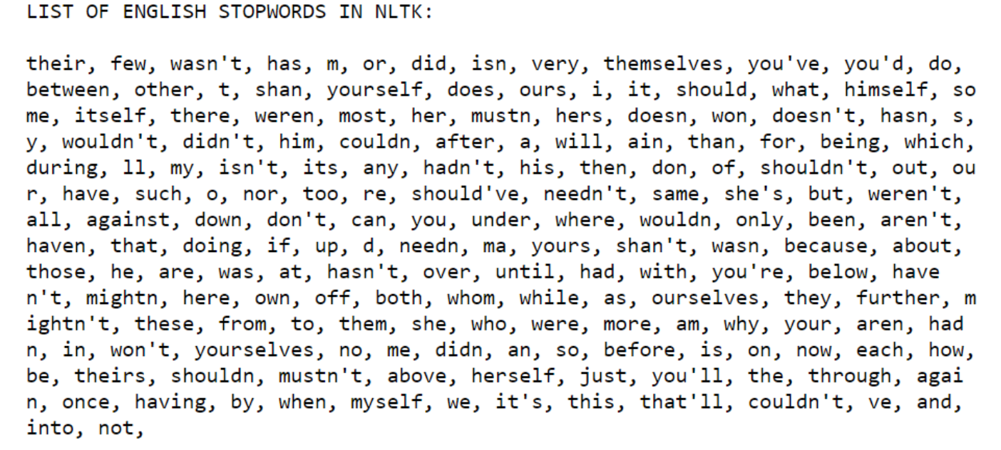
Text Preprocessing
Stop-word Removal
13

Slide 14
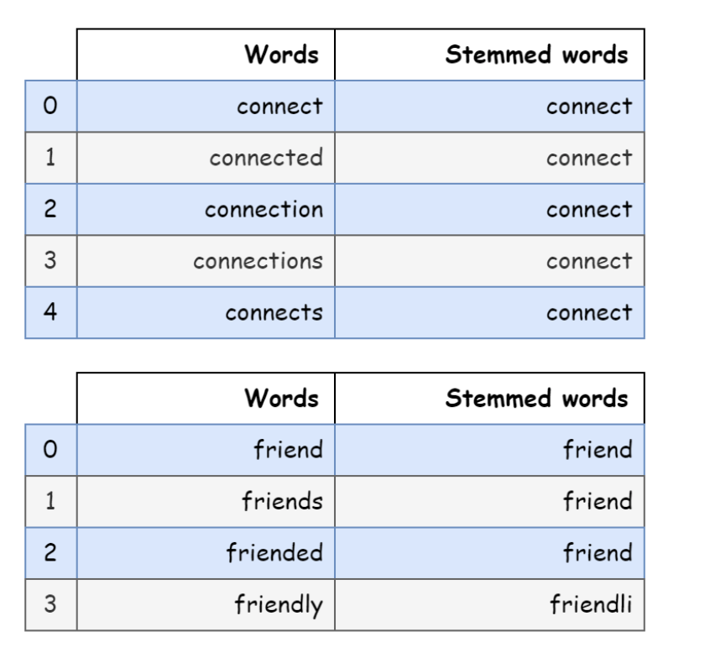

Text Preprocessing
Stemming
Stemming is the process of reducing a word to its root form by removing suffixes or prefixes.
14

Slide 15
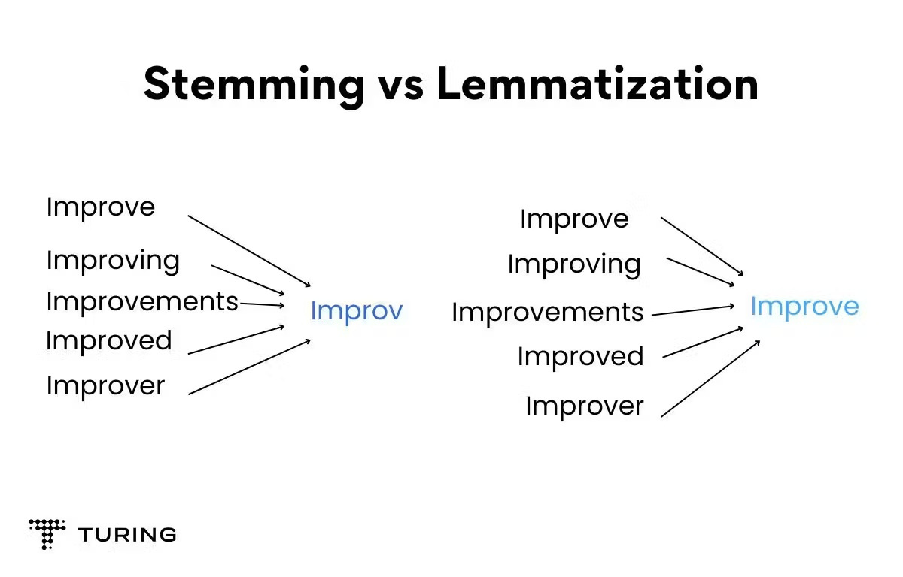
Text Preprocessing
Lemmatization
Reduces words to their dictionary base form (lemma) using vocabulary and grammar.
15

Slide 16
Text Preprocessing
Tokenization
The process of splitting text into smaller units, called tokens, which may be:
Token
Sentence
Characters
Word
Subwords
16

Slide 17
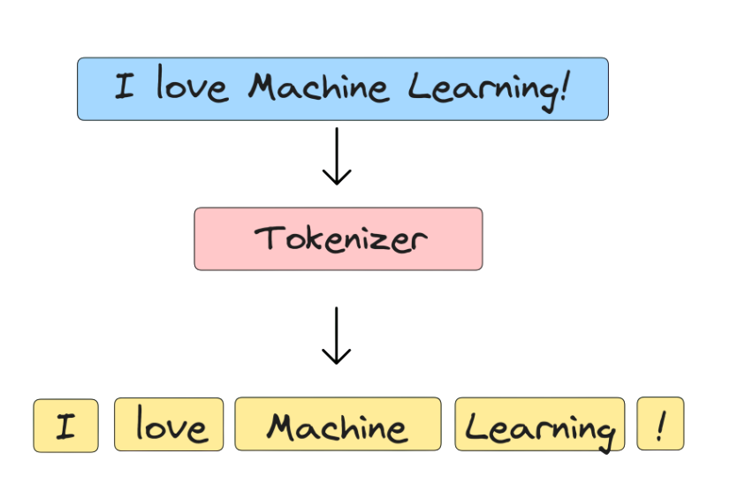
Text Preprocessing
Tokenization
Word Tokenization
17

Slide 18
Text Preprocessing
Tokenization
Subword Tokenization
Training Corpus
Split all words into characters
low
lower
lowest
newest
l o w
l o w e r
l o w e s t
n e w e s t
18

Slide 19
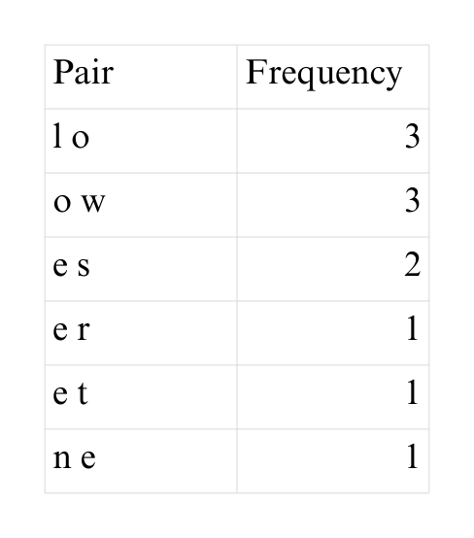
Text Preprocessing
Tokenization
Subword Tokenization
Training Corpus
Split all words into characters
Training Corpus
low
lower
lowest
newest
l o w
l o w e r
l o w e s t
n e w e s t
19

Slide 20
Text Preprocessing
Tokenization
Subword Tokenization
Merge the most frequent pair
lo w
lo w e r
lo w e s t
n e w e s t
low
low e r
low e s t
n e w e s t
low
lower
lowes t
ne wes t
20

Slide 21
Text Preprocessing
Tokenization
Subword Tokenization
Merge the most frequent pair
lo w
lo w e r
lo w e s t
n e w e s t
low
low e r
low e s t
n e w e s t
low
lower
lowes t
new est
[low, er, est, new]
21

Slide 22
Text Representation
22

Slide 23

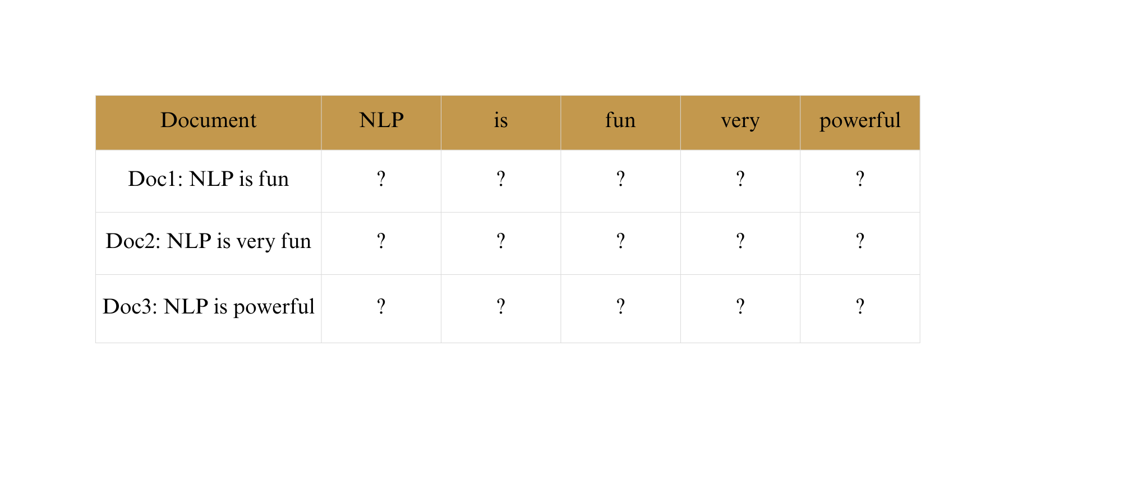
Text Representation
Converting text into numerical form so that machine learning models can process it
Bag-of-Words
23

Slide 24
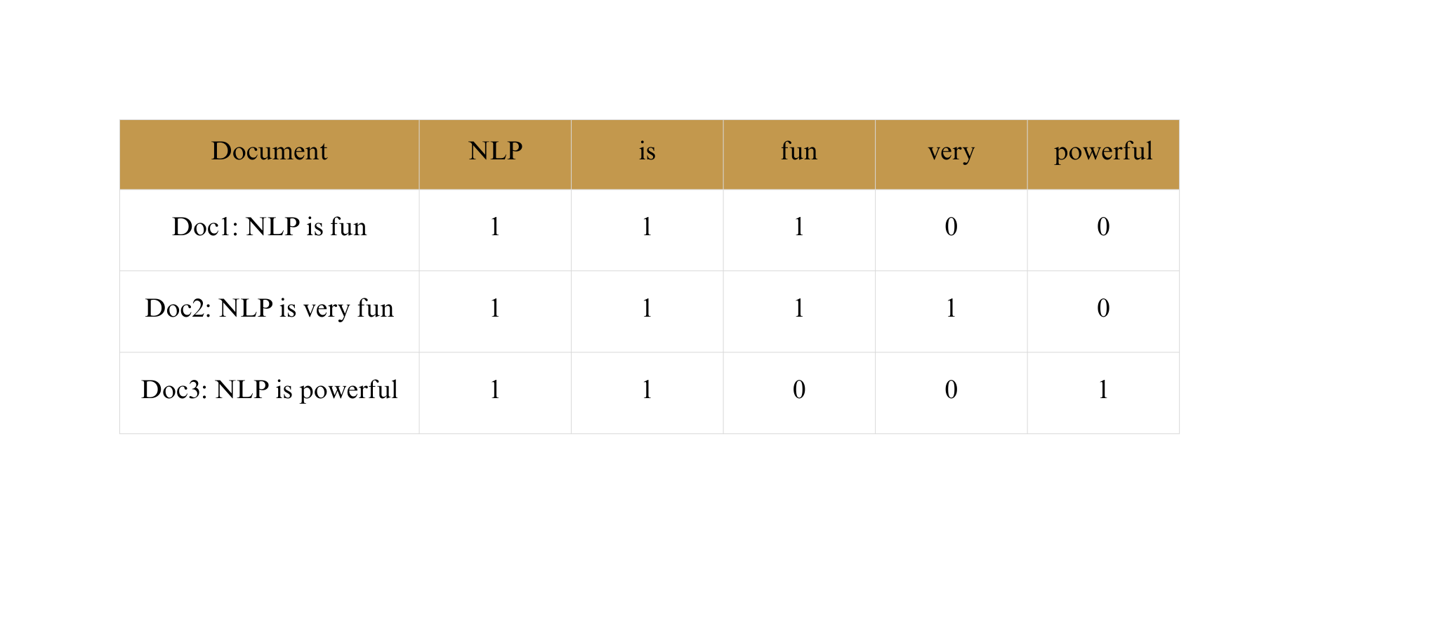
Text Representation
Converting text into numerical form so that machine learning models can process it
Bag-of-Words
24

Slide 25
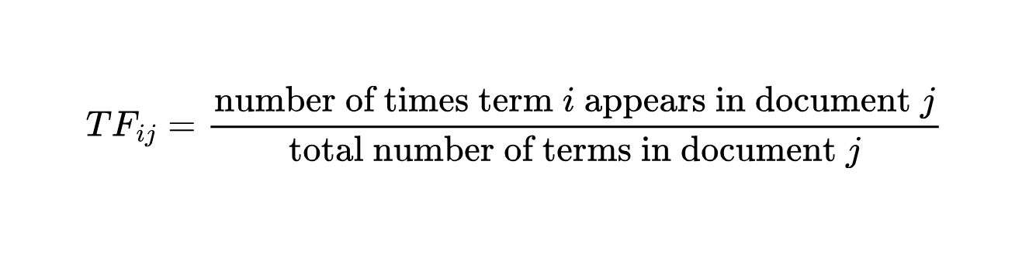
Text Representation
TF-IDF
Term Frequency (TF)
Measures how often a word appears in a document
25

Slide 26
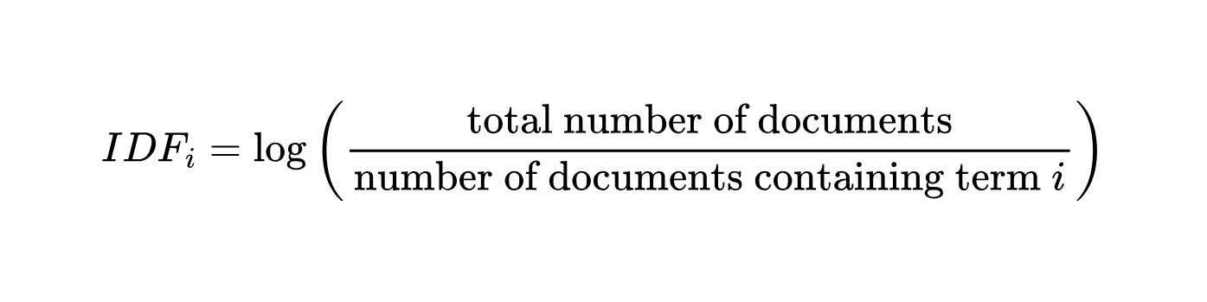
Text Representation
TF-IDF
Inverse Document Frequency (IDF)
Measures how rare or common a word is across the corpus
26

Slide 27
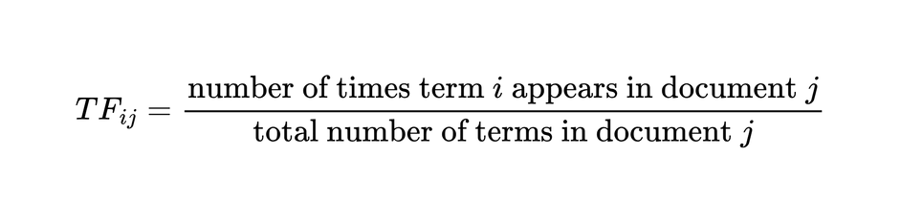
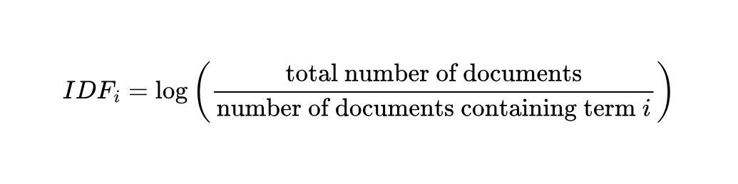
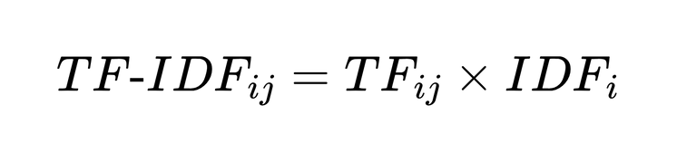
Text Representation
TF-IDF
High IDF ⇒ word is rare but valuable
Low IDF ⇒ word is common (e.g., “the”, “a”, “and”)
27

Slide 28
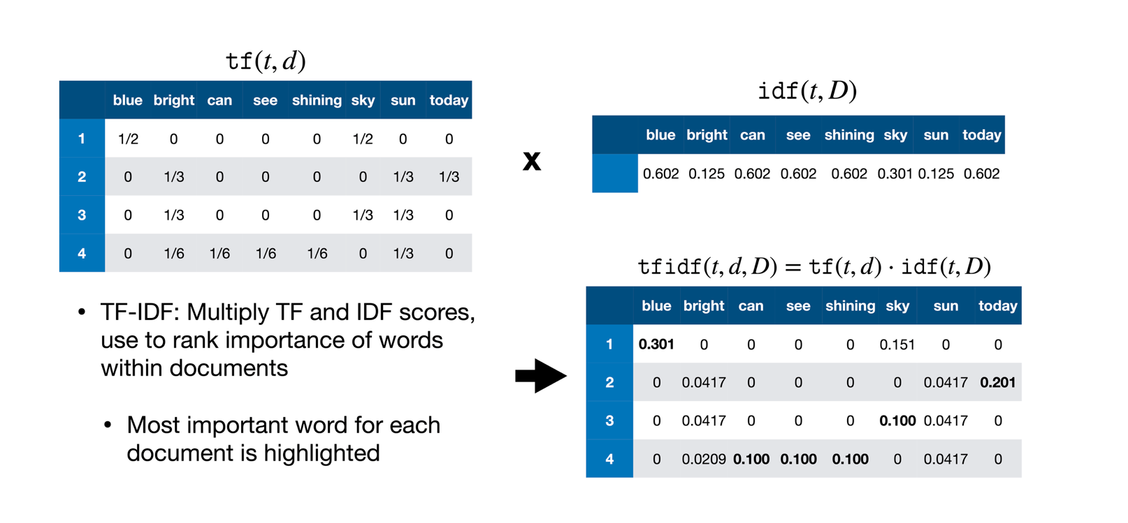
Text Representation
TF-IDF
28

Slide 29
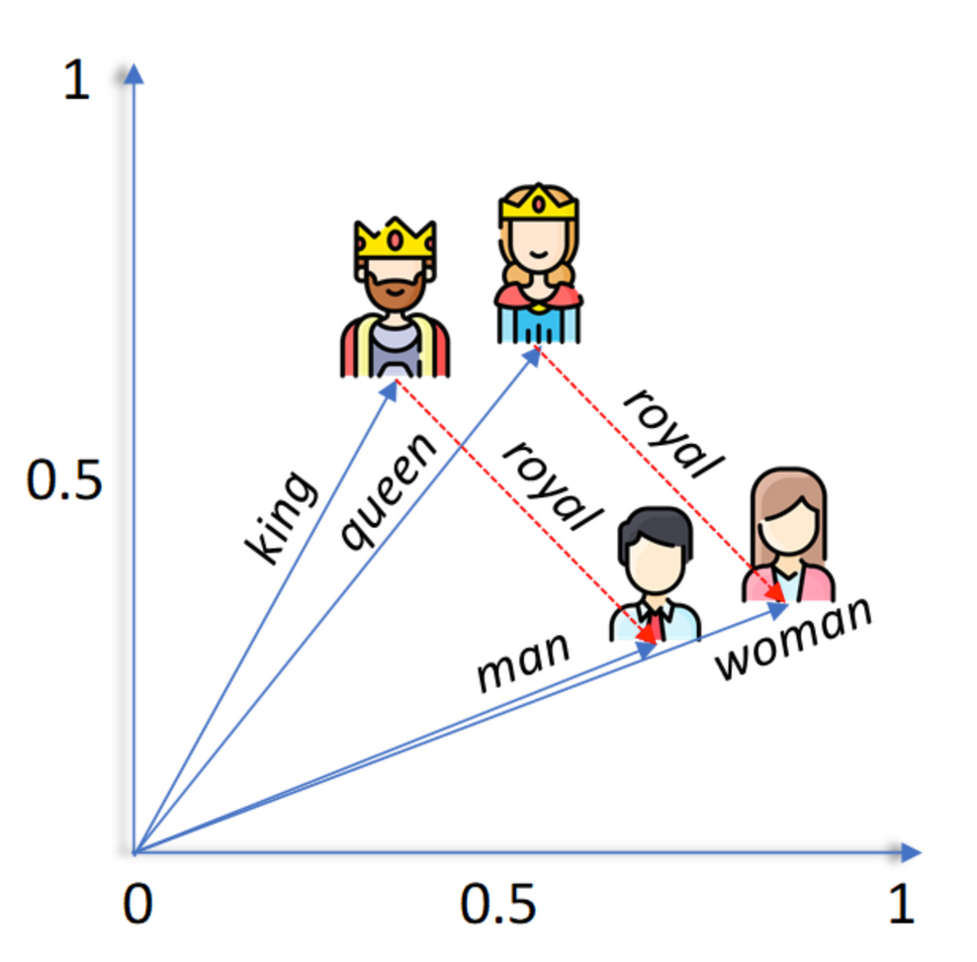

Text Representation
Vector Space Model
VSM Represents words or documents as vectors in an n-dimensional space.
Based on the distributional hypothesis: Words that occur in similar contexts have similar meanings.
29

Slide 30
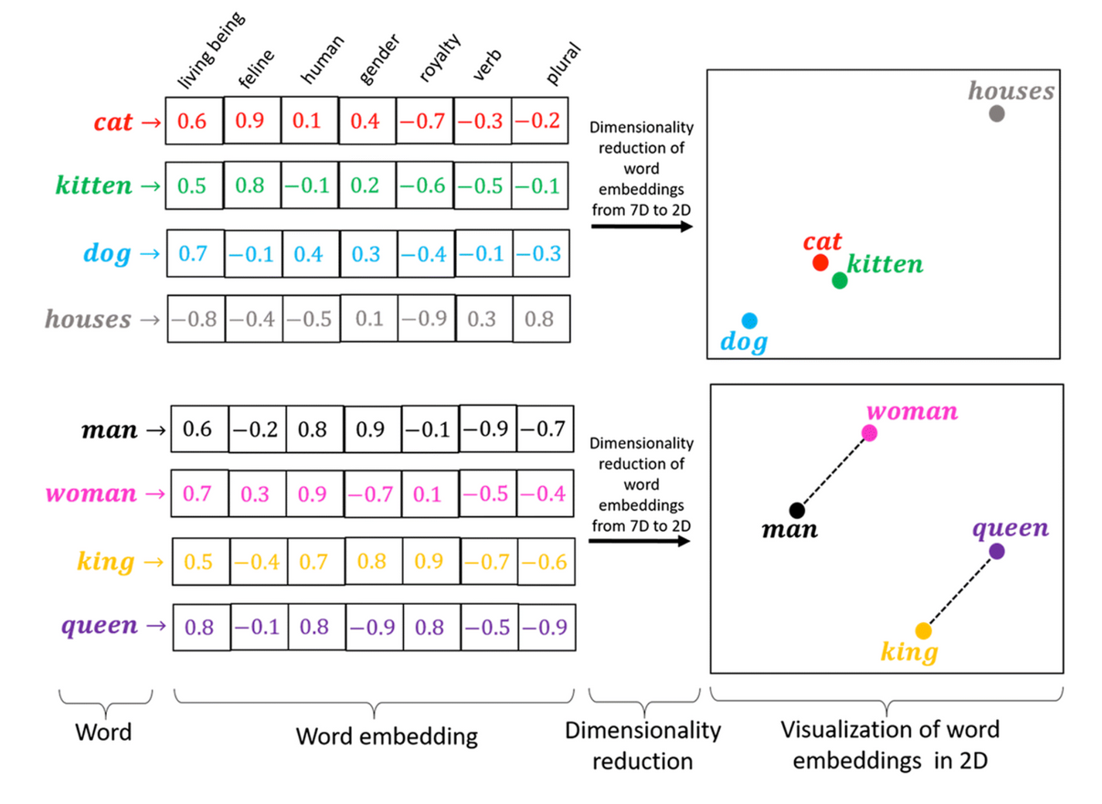
Text Representation
Word2Vec
Represents words as vectors such that words appearing in similar contexts have similar meanings.
Similar words have similar vector representations
30

Slide 31
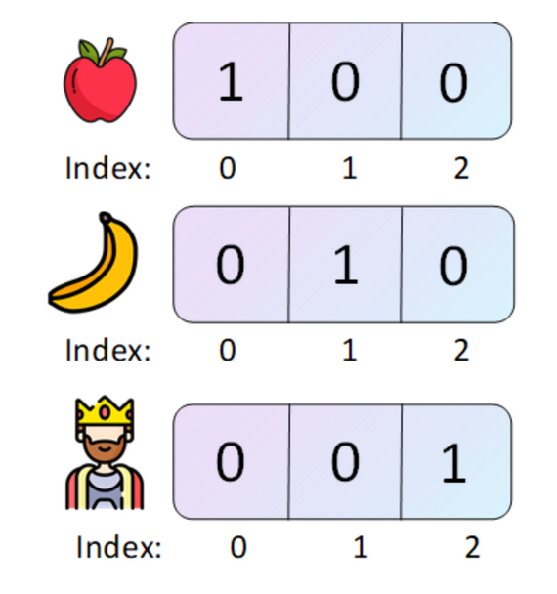
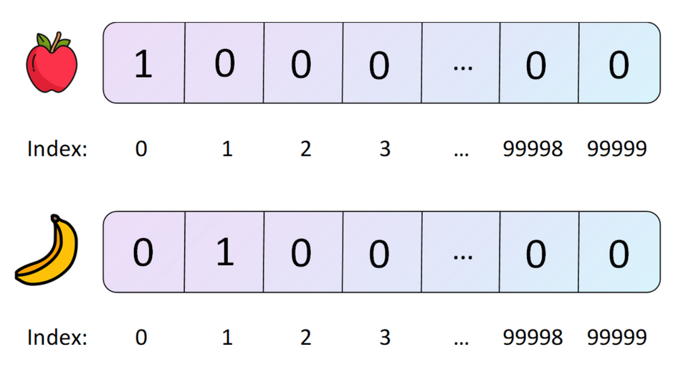
Text Representation
Word2Vec
Dense Representation
Sparse Representation
No semantic meaning
Very high-dimensional and sparse
Captures semantic meaning
31

Slide 32
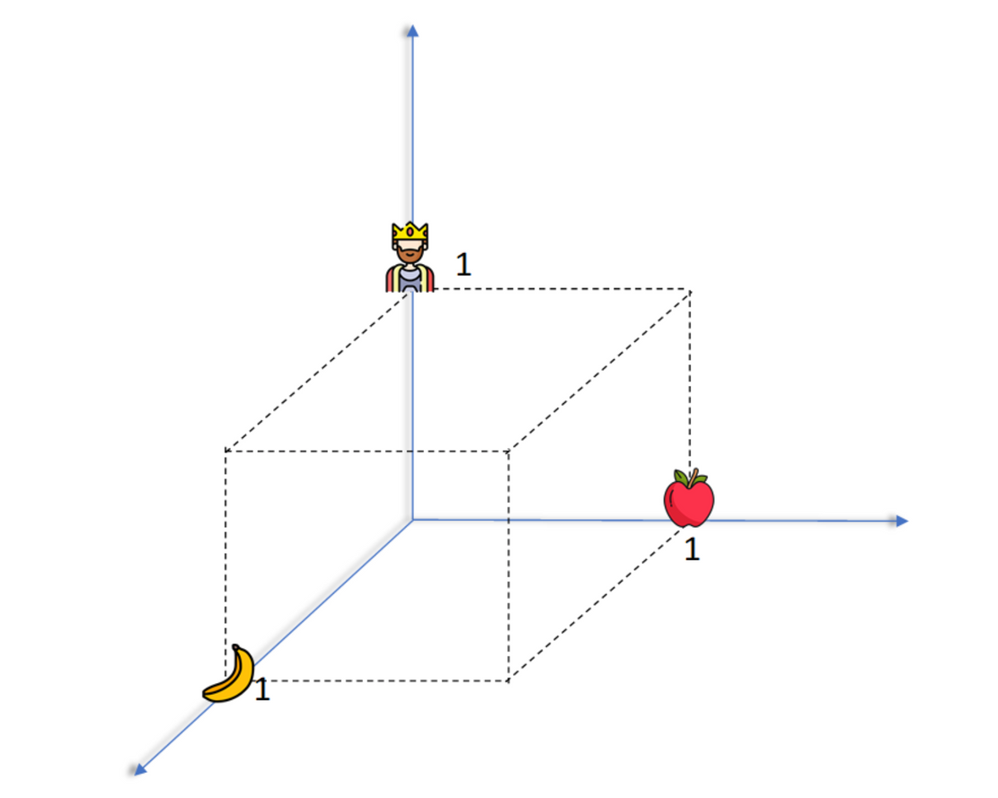
Text Representation
Word2Vec
If we plot these vectors in a 3D coordinate system, each axis corresponds to one dimension of the vocabulary
32

Slide 33
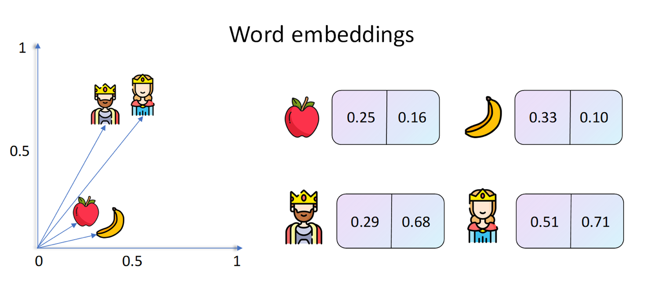
Text Representation
Word2Vec
Similar words have similar vectors, leading to meaningful distances in embedding space.
33

Slide 34
Text Representation
Word2Vec
Word embeddings preserve relationships, not just individual word meanings.
34

Slide 35
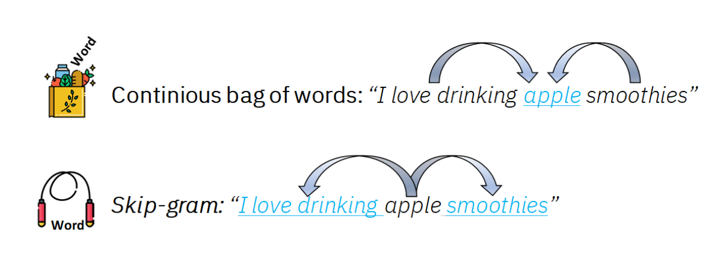
Text Representation
Word2Vec
Word2Vec learns embeddings using either CBOW or Skip-Gram training objectives.
35

Slide 36
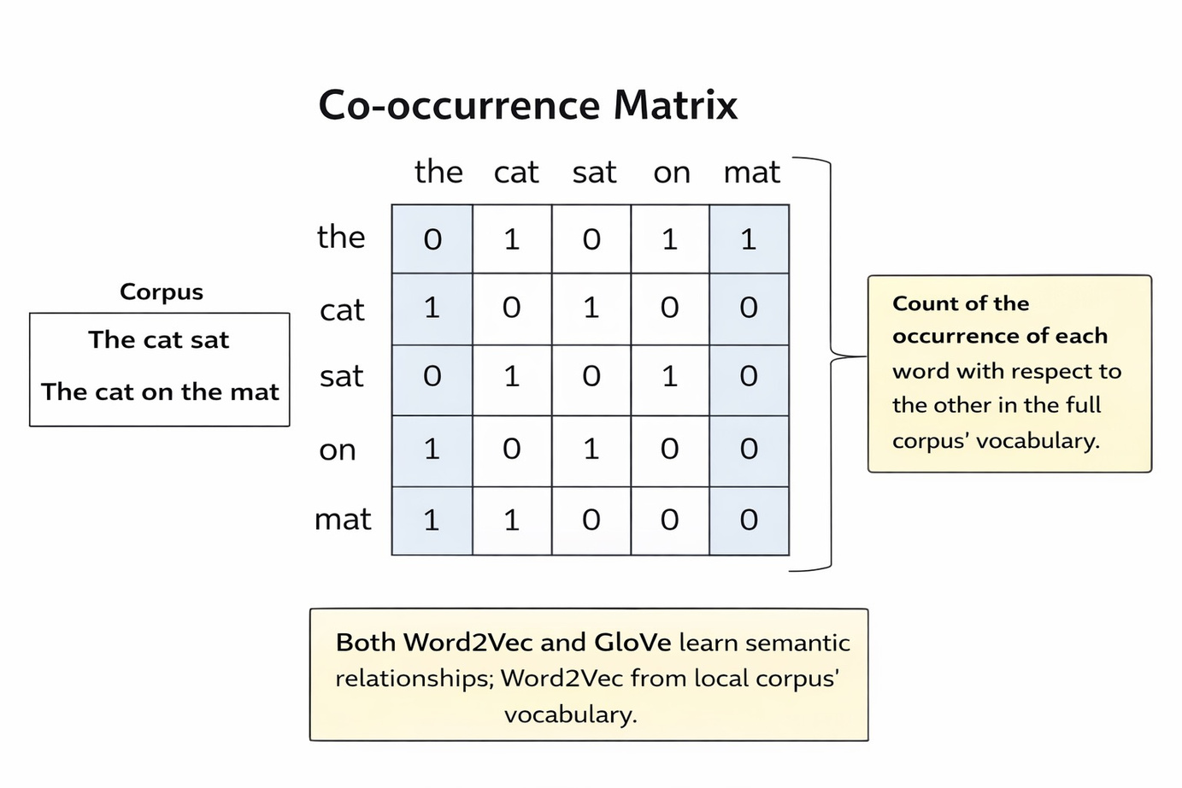
Text Representation
Global Vectors
GloVe is a word embedding method that learns dense vector representations by combining global word co-occurrence statistics with vector space learning.
36

Slide 37
Recurrent Neural Network
37

Slide 38
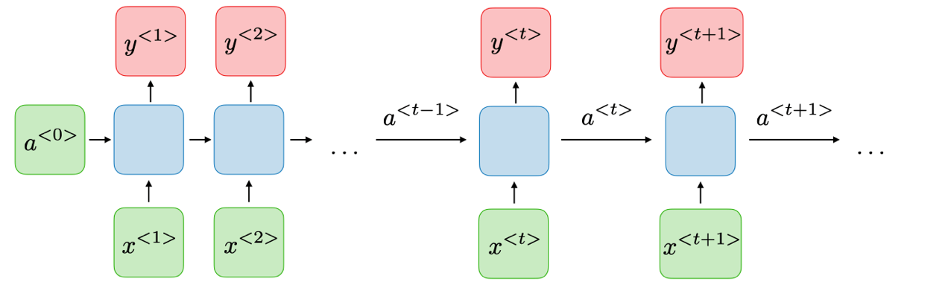
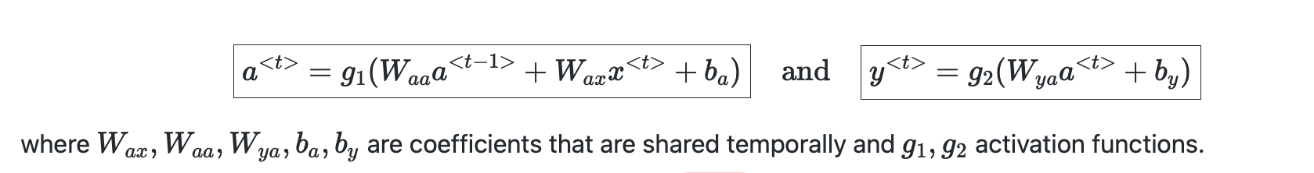
Recurrent neural network
RNN Basic Structure
*
38

Slide 39
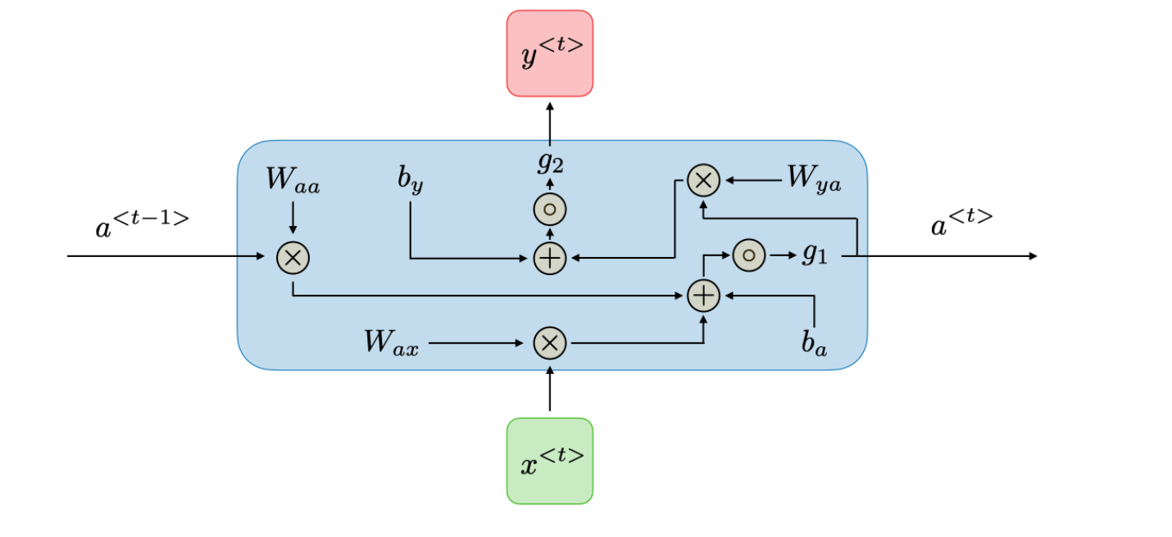
Recurrent neural network
RNN Basic Structure
*
39

Slide 40
Recurrent neural network
RNN Basic Structure
*
*
40

Slide 41
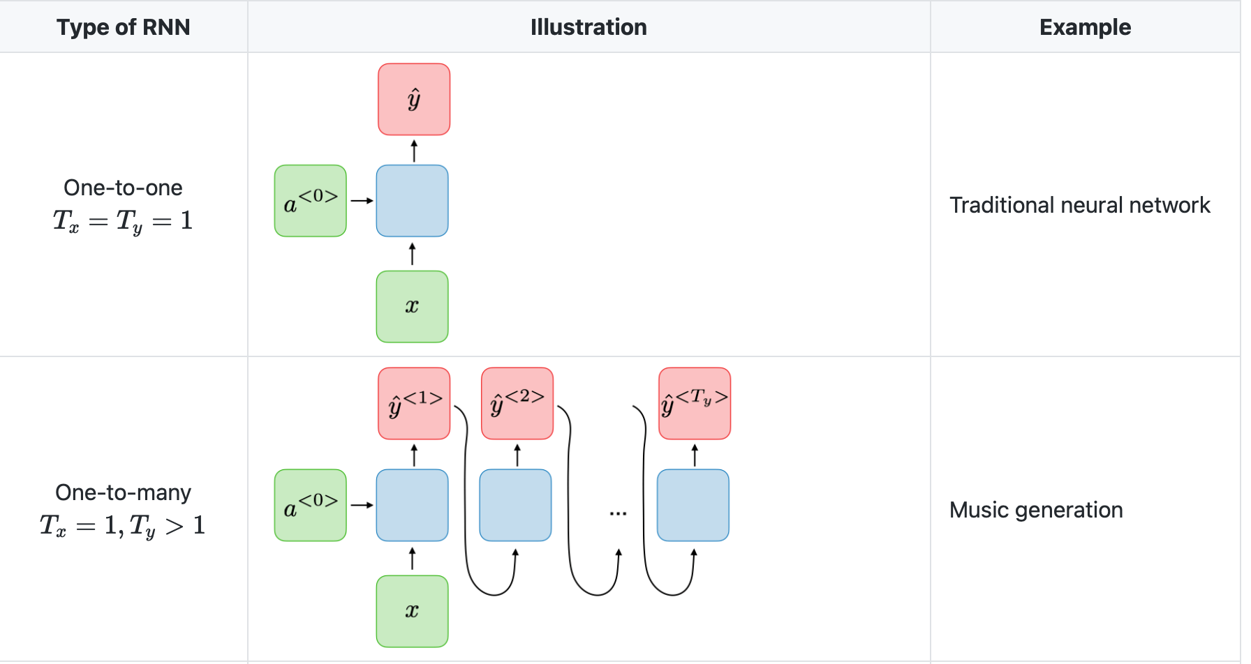
Recurrent neural network
RNN Types
41

Slide 42
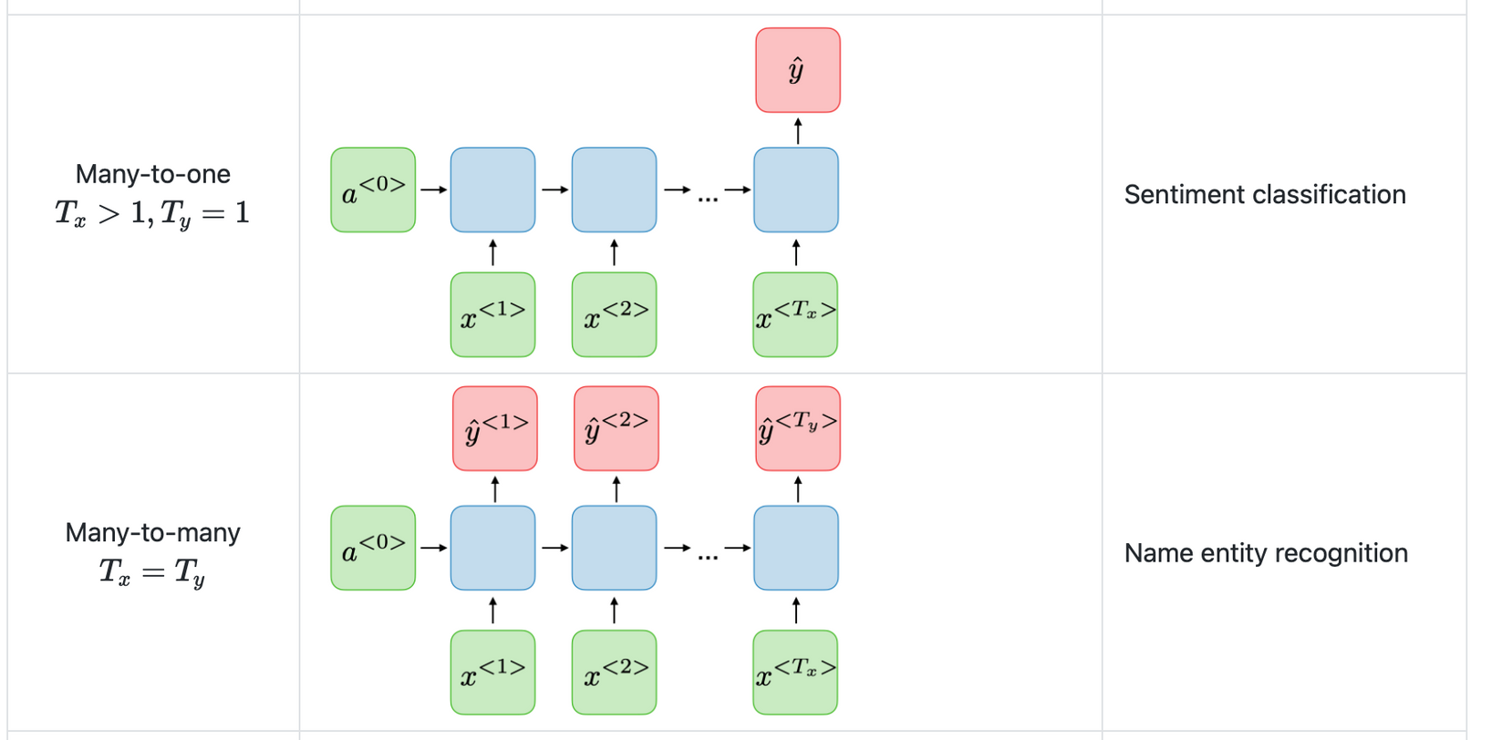
Recurrent neural network
RNN Types
*
42

Slide 43
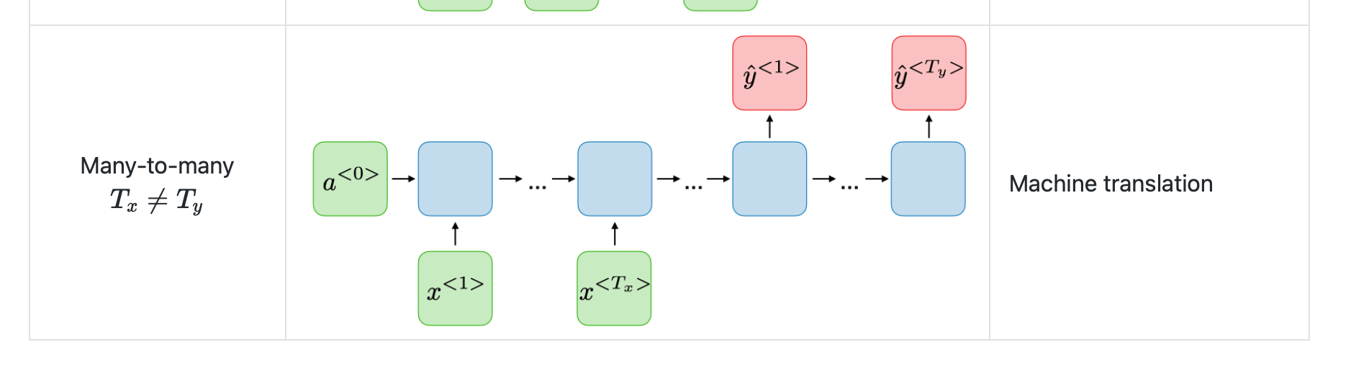
Recurrent neural network
RNN Types
*
43

Slide 44
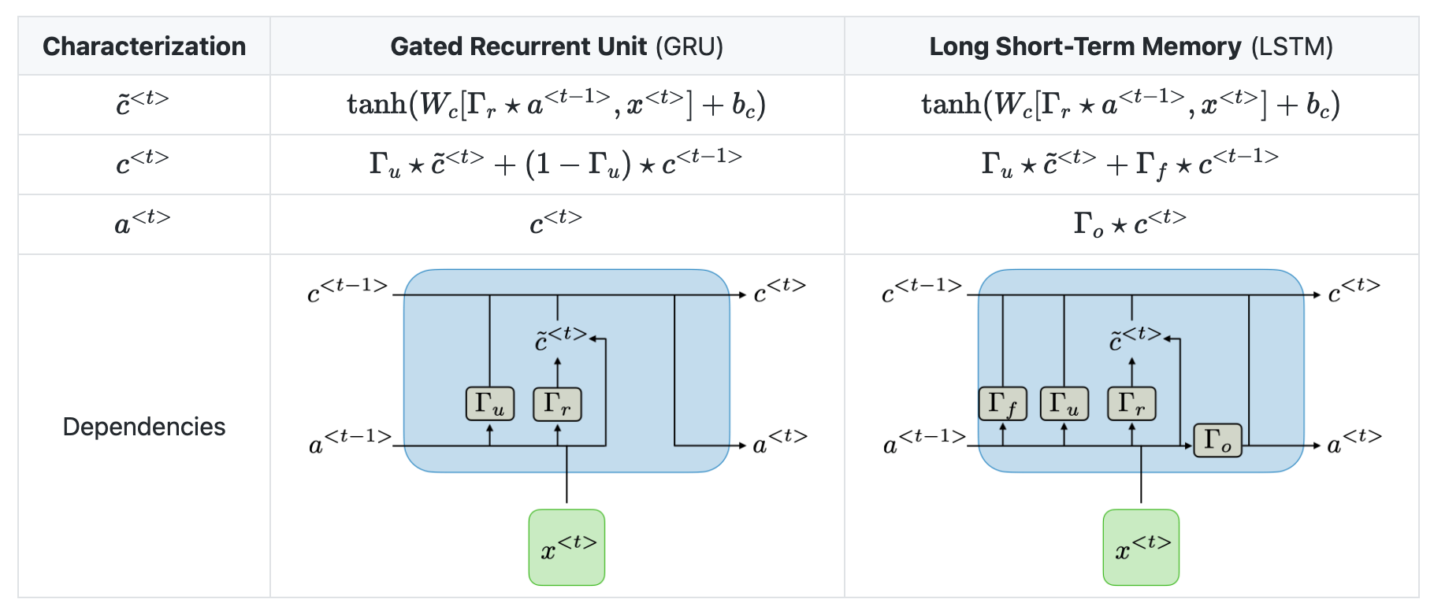
Recurrent neural network
GRU/LSTM
*
44

Slide 45
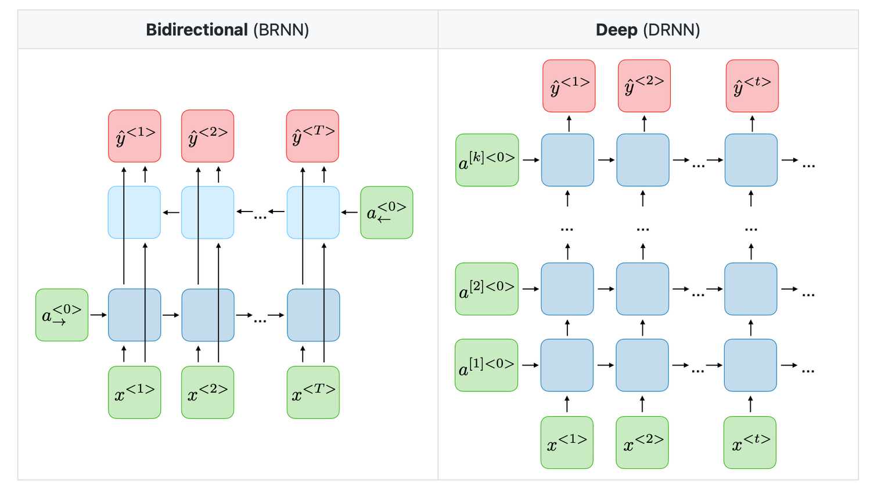
Recurrent neural network
Variants of RNNs
*
45

Slide 46
Transformers
46

Slide 47
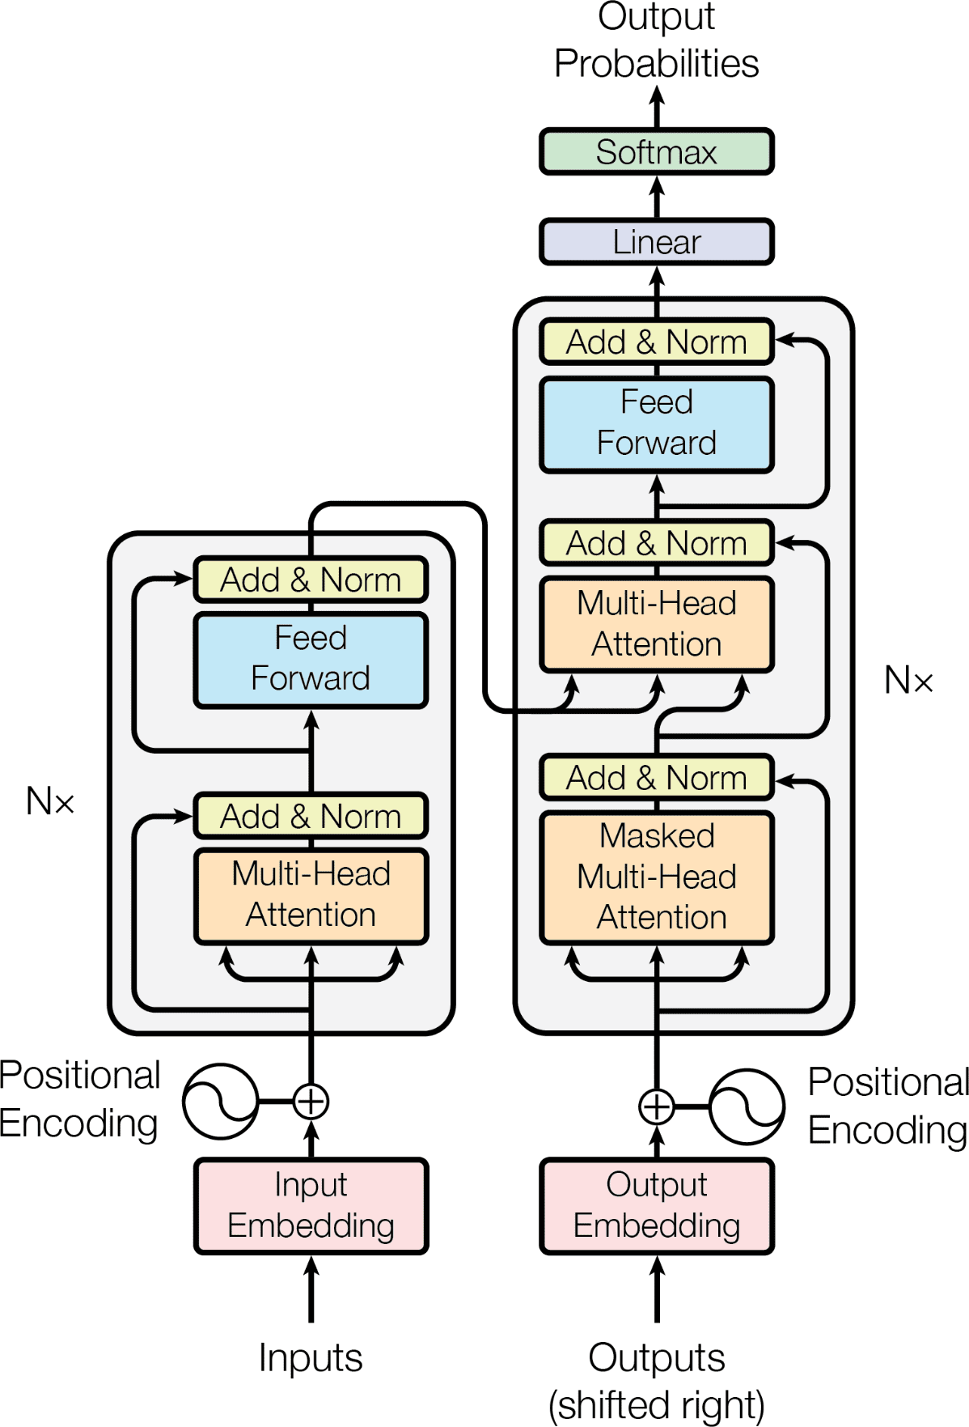
Transformers
Tokenizaton
Input Embeddings
Position Encodings
Residuals
Query
Key
Value
Add & Norm
Encoder
Decoder
Attention
Self Attention
Multi Head Attention
Masked Attention
Encoder Decoder Attention
Output Probabilities / Logits
Softmax
Encoder-Decoder models
Decoder only models

Slide 48
Machine Translation
Targets
Ich have einen apfel gegessen
Inputs
I ate an apple

Slide 49
Inputs
Processing Inputs
Inputs
I ate an apple

Slide 50
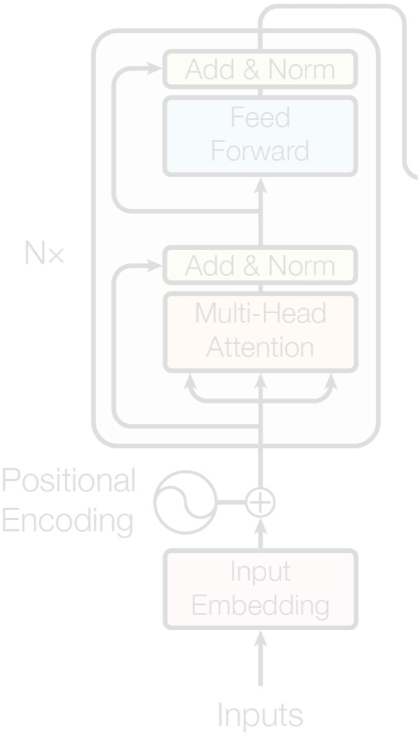

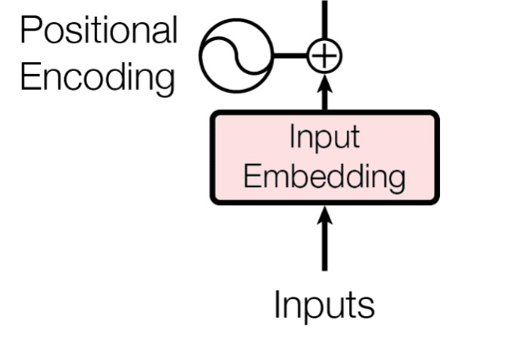

Inputs
I
ate
an
apple
<eos>
Tokenizer
I ate an apple
Generate Input Emebeddings

Slide 51




Inputs
dmodel
Embedding Layer
I
ate
an
apple
<eos>
Tokenizer
I ate an apple
Generate Input Emebeddings

Slide 52
Positional Encoding
I
ate
an
apple
<eos>

Slide 53
Positional Encoding
I
ate
an
apple
<eos>
apple
ate
an
I
<eos>
Positional Encoding

Slide 54
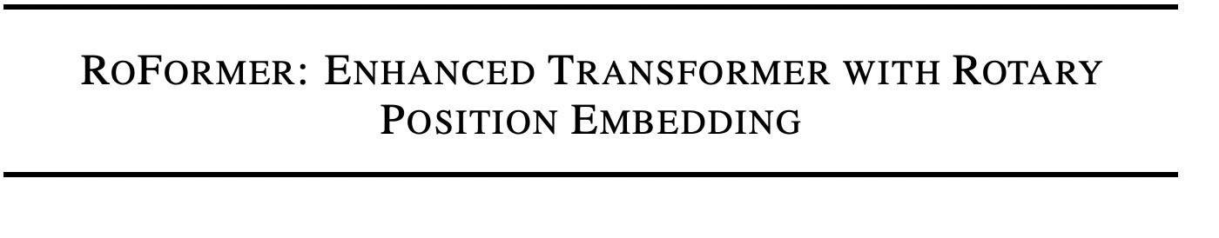
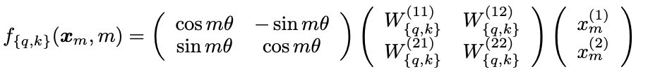
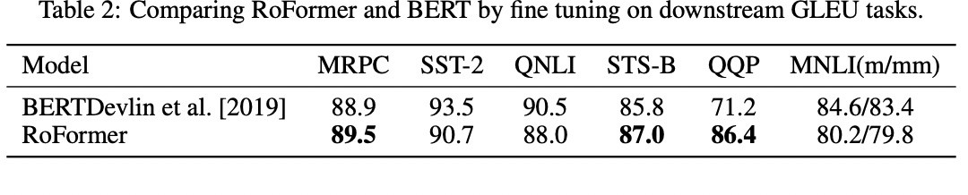

Rotary Positional Embedding
REF: Rotary Positional Embeddings

Slide 55
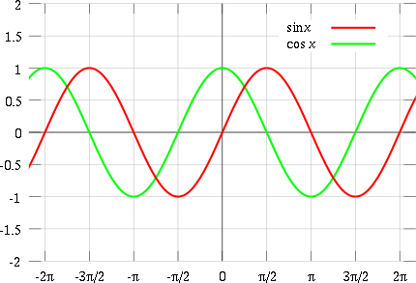
Positional Encoding
Requirements for Positional Encodings
Some representation of time ? (like seq2seq ?)
Should be unique for each position – not cyclic
Bounded
Actual Candidates :
sine(g(t))
cosine(g(t))
Positional Encoding

Slide 56


Positional Encoding
Final Input Embeddings
Position Encodings Input Embeddings
Embedding Layer
I
ate
an
apple
<eos>
Tokens
Tokenizer
I ate an apple
Input
57

Slide 57
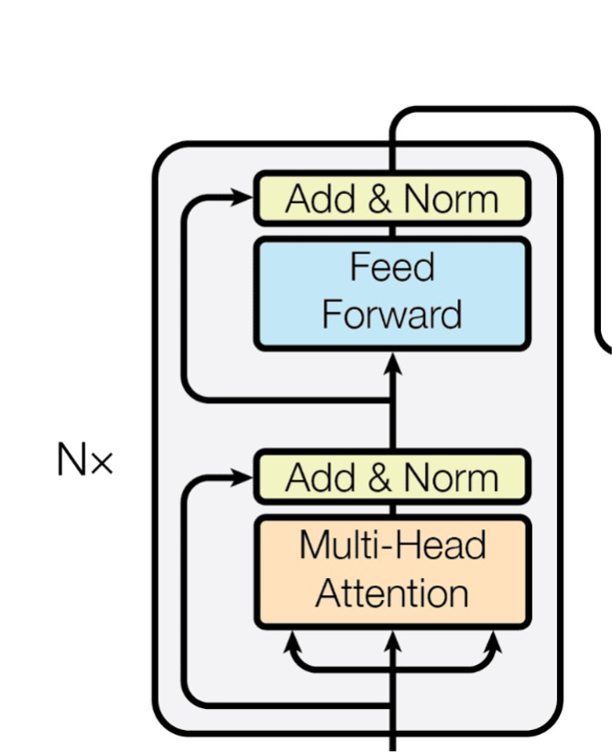


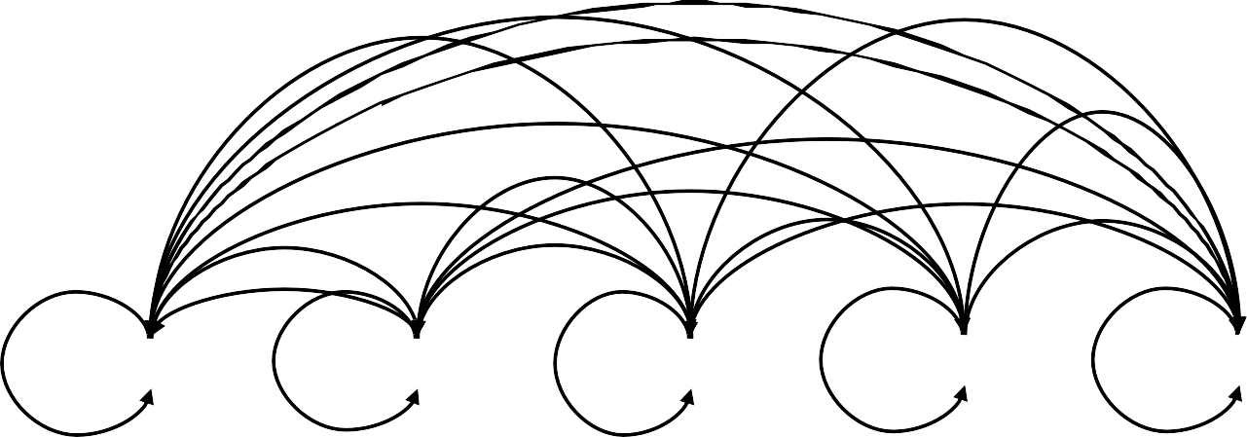



Encoder
CONTEXTUALLY RICH EMBEDDINGS
BLACK BOX OF SORTS
 | LEARN TO ADD CONTEXT
I
ate
an
apple
<eos>

Slide 58
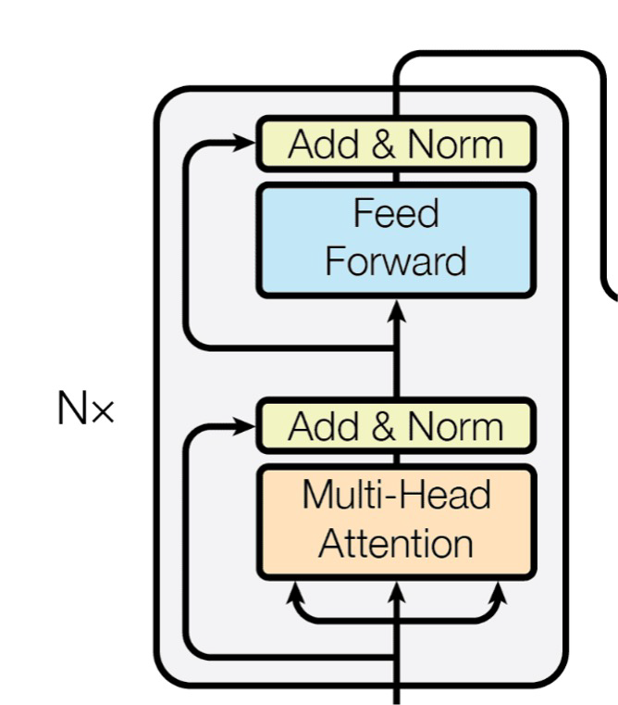
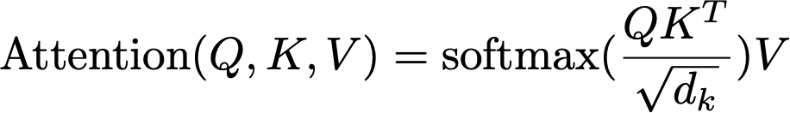
Self Attention

Slide 59
Self Attention
The
animal
didn’t
cross
the
street
because
it
was
too
wide

Slide 60
Self Attention
?
The
animal
didn’t
cross
the
street
because
it
was
too
wide
coreference resolution ?

Slide 61
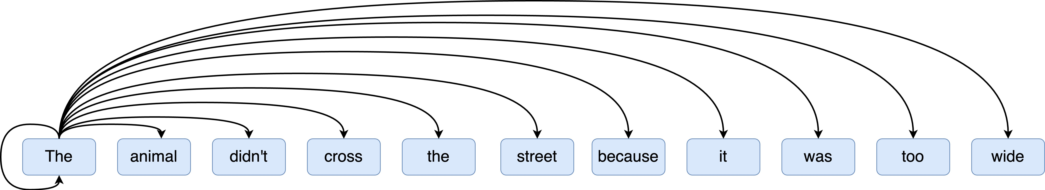
Self Attention

Slide 62
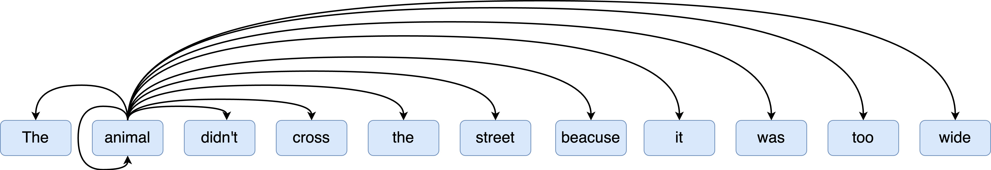
Self Attention

Slide 63
Self Attention

Slide 64
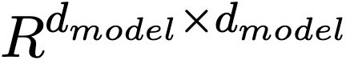
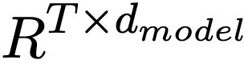
Self Attention
W_{Q}
W_{K}
W_{v}
Input Embeddings

Slide 65


Multi-Head Attention
 |  |  |  |  |  | ..
 |  |  |  |  | 2
H
H
H
..
..
1
^{W}Q1, ^{W}Q2, … ^{W}QH,
2
2
1
1
^{W}K1, ^{W}K2, … ^{W}KH,
^{W}V1, ^{W}V2, … ^{W}VH,
Input Embeddings

Slide 66






Multi-Head Attention
The
animal
didn’t
cross
the
street
because
it
was
too
wide
Sentence boundaries ?
coreference resolution
Context ?
Semantic relationships ?
Part of Speech ?
Comparisons ?

Slide 67

Add & Norm
Input
Norm(Z)
Normalization(Z)
Mean 0, Std dev 1
Stabilizes training
Regularization effect
Add -> Residuals
Avoid vanishing gradients
Train deeper networks

Slide 68



Feed Forward
Feed Forward
Non Linearity
Complex Relationships
Learn from each other
Feed Forward
Residuals
Input
Norm(Z)

Slide 69
Add & Norm
Add & Norm
Feed Forward
Residuals
Input
Norm(Z)

Slide 70

Encoders
Encoder
ENCODER

Slide 71
Encoders
Encoder
ENCODER
.
.
.
Input to Encoder_{i+1}
ENCODER
Output from Encoder_{i}
ENCODER

Slide 72
Machine Translation
Targets
Ich have einen apfel gegessen
Inputs
I ate an apple

Slide 73


Targets
Targets
Ich have einen apfel gegessen

Slide 74






Targets
Embedding Layer + Positional Encoding
<sos>
Ich
have
einen
apfel
gegessen
<eos>
Tokenizer
Ich have einen apfel gegessen
Generate Target Emebeddings

Slide 75

Masked Multi Head Attention
<sos>
Ich
have
einen
apfel
gegessen
<eos>

Slide 76
Masked Multi Head Attention
Decoding step by step (using Teacher Forcing)
Inference
1 <sos>
<sos>
<sos>
<sos>
5 <sos>
<sos>
7 <sos>
2
Ich
Ich
3
have
4
Ich
Ich
have
have
einen
einen
apfel
6
Ich
have
einen
apfel
gegessen
Ich
have
einen
apfel
gegessen
<eos>

Slide 77
Masked Multi Head Attention
Decoding step by step (using Teacher Forcing)
Inference
1 <sos>
<sos>
<sos>
<sos>
5 <sos>
<sos>
7 <sos>
2
Ich
Ich
3
have
Parallelized ?
4
Ich
Ich
have
have
einen
einen
apfel
6
Ich
have
einen
apfel
gegessen
Ich
have
einen
apfel
gegessen
<eos>

Slide 78
Masked Multi Head Attention
Decoding step by step (using Teacher Forcing)
Training
<sos>
Ich
have
einen
apfel
gegessen
<eos>

Slide 79
Masked Multi Head Attention
Decoding step by step (using Teacher Forcing)
Training
<sos>
Ich have einen apfel gegessen
Outputs at time T should only pay attention to outputs until time T-1
<eos>

Slide 80
Masked Multi Head Attention
Decoding step by step (using Teacher Forcing)
1 <sos>
<sos>
<sos>
<sos>
5 <sos>
<sos>
7 <sos>
Ich
have
einen
apfel
gegessen
<eos>
2
Ich
Ich
have
have
einen
apfel
gegessen
<eos>
3
einen
apfel
gegessen
<eos>
4
Ich
Ich
have
have
einen
einen
apfel
apfel
gegessen
<eos>
gegessen
<eos>
6
Ich
have
einen
apfel
gegessen
<eos>
<eos>
Ich
have
einen
apfel
gegessen

Slide 81
Masked Multi Head Attention
Decoding step by step (using Teacher Forcing)
1 <sos>
<sos>
<sos>
<sos>
5 <sos>
<sos>
7 <sos>
Ich
have
einen
apfel
gegessen
<eos>
2
Ich
Ich
have
have
einen
apfel
gegessen
<eos>
3
einen
apfel
gegessen
<eos>
4
Ich
Ich
have
have
einen
einen
apfel
apfel
gegessen
<eos>
gegessen
<eos>
6
Ich
have
einen
apfel
gegessen
<eos>
<eos>
Ich
have einen apfel gegessen
Mask the available attention values ?

Slide 82





















Masked Multi Head Attention
Decoding step by step (using Teacher Forcing)
1 <sos>
<sos>
<sos>
<sos>
5 <sos>
<sos>
7 <sos>
-
-
-
-
-
-
2
Ich
Ich
-
-
-
-
-
3
have
-
-
-
-
4
Ich
Ich
have
have
einen -
einen
-
-
apfel
-
-
6
Ich
have
einen
apfel
gegessen
-
Ich
have
einen
apfel
gegessen
<eos>

Slide 83

Masked Multi Head Attention
Decoding step by step (using Teacher Forcing)
1 <sos>
<sos>
<sos>
<sos>
5 <sos>
<sos>
7 <sos>
-
-
-
-
-
-
2
Ich
Ich
-
-
-
-
-
3
have
-
-
-
-
4
Ich
Ich
have
have
einen -
einen
-
-
apfel
-
-
6
Ich
have
einen
apfel
gegessen
-
Ich
have
einen apfel
Softmax -> 0-.
gegessen
<eos>
-> 0

Slide 84


Masked Multi Head Attention
Masked Multi Head Attention
=
QK^{T}
Attention Mask: M
Masked Attention
Masked Multi Head Attention : Z’

Slide 85


Masked Multi Head Attention
Masked Multi Head Attention
Masked Attention
Values
Masked Multi Head Attention : Z’

Slide 86

Encoder Decoder Attention
Encoder Decoder Attention ?
Add & Norm
Input
Norm(Z’)
100

Slide 87
Encoder Decoder Attention
Encoder Decoder Attention ?

Slide 88
Encoder Decoder Attention
Encoder
Decoder
Keys from Encoder Outputs
Values from Encoder Outputs
Queries from Decoder Inputs
NOTE: Every decoder block receives the same FINAL encoder output

Slide 89





Encoder Decoder Attention
Z’’
( ) %
softmax( # $ ).
V_{e}
*&'#$(
( ) %
softmax( # $ )
*&'#$(
Q_{d} K_{e}

Slide 90

Encoder Decoder Attention
Non Linearity
Complex Relationships
Learn from each other
Feed Forward
Residuals
Add n Norm Decoder Self Attn
Norm(Z’’)
106

Slide 91
Decoder
DECODER

Slide 92
Decoder
DECODER
.
.
.
DECODER
Decoder output
DECODER

Slide 93




Linear
Linear weights are often tied with input embedding matrix
softmax
…
Final Decoder Output
Linear

Slide 94
Softmax
Output Probabilities
V
T_{d}
…

Slide 95
Transformers
Targets
Ich have einen apfel gegessen
Inputs
I ate an apple
Machine Translation

Slide 96
Large Language Models
50

Slide 97
Transformers, mid-2017

Slide 98
Transformers, mid-2017
Representation

Slide 99
Transformers, mid-2017
Representation
Generation

Slide 100
Transformers, mid-2017
Input – input tokens
Output – hidden states
Input – output tokens and hidden states*
Output – output tokens
Representation
Generation

Slide 101
Transformers, mid-2017
Input – input tokens
Output – hidden states
Input – output tokens and hidden states*
Output – output tokens
Model can see all timesteps
Model can only see previous timesteps
Representation
Generation

Slide 102
Transformers, mid-2017
Input – input tokens
Output – hidden states
Input – output tokens and hidden states*
Output – output tokens
Model can see all timesteps
Model can only see previous timesteps
Does not usually output tokens, so no inherent auto-regressivity
Model is auto-regressive with previous timesteps’ outputs
Representation
Generation

Slide 103
Transformers, mid-2017
Input – input tokens
Output – hidden states
Input – output tokens and hidden states*
Output – output tokens
Model can see all timesteps
Model can only see previous timesteps
Does not usually output tokens, so no inherent auto-regressivity
Model is auto-regressive with previous timesteps’ outputs
Can also be adapted to generate tokens by appending a module that maps hidden state dimensionality to vocab size
Can also be adapted to generate hidden states by looking before token outputs
Representation
Generation

Slide 104
2018 – The Inception of the LLM Era
BERT Oct 2018
GPT Jun 2018
Representation
Generation

Slide 105
BERT - Bidirectional Encoder
Representations
One of the biggest challenges in LM-building used to be the lack of task-specific training data.
What if we learn an effective representation that can be applied to a variety of downstream tasks?
Word2vec (2013)
GloVe (2014)

Slide 106
BERT - Bidirectional Encoder
Representations
BERT Pre-Training Corpus:
English Wikipedia - 2,500 million words
Book Corpus - 800 million words

Slide 107
BERT - Bidirectional Encoder
Representations
BERT Pre-Training Corpus:
English Wikipedia - 2,500 million words
Book Corpus - 800 million words
BERT Pre-Training Tasks:
MLM (Masked Language Modeling)
NSP (Next Sentence Prediction)

Slide 108
BERT - Bidirectional Encoder
Representations
BERT Pre-Training Corpus:
English Wikipedia - 2,500 million words
Book Corpus - 800 million words
BERT Pre-Training Tasks:
MLM (Masked Language Modeling)
NSP (Next Sentence Prediction)
BERT Pre-Training Results:
BERT-Base – 110M Params
BERT-Large – 340M Params

Slide 109
BERT - Bidirectional Encoder
Representations
MLM (Masked Language Modeling)
you 60%
they 20%
… …
Prediction head
<CLS>
How
are
<MASK>
doing
today
<SEP>
BERT
<CLS>
How
are
<MASK>
doing
today
<SEP>

Slide 110
BERT - Bidirectional Encoder
Representations
MLM (Masked Language Modeling)
is_next not_next
95%
5%
Prediction head
<CLS>
…
…
<SEP>
…
…
<SEP>
BERT
<CLS>
…
…
<SEP>
…
…
<SEP>

Slide 111
BERT - Bidirectional Encoder
Representations
BERT Fine-Tuning:
Simply add a task-specific module after the last encoder layer to map it to the desired dimension.
Classification Tasks:
Add a feed-forward layer on top of the encoder output for the [CLS] token
Question Answering Tasks:
Train two extra vectors to mark the beginning and end of answer from paragraph
…

Slide 112
BERT - Bidirectional Encoder
Representations
BERT Evaluation:
General Language Understanding Evaluation (GLUE)
Sentence pair tasks
Single sentence classification
Standford Question Answering Dataset (SQuAD)

Slide 113


BERT - Bidirectional Encoder
Representations
BERT Evaluation:

Slide 114
BERT - Bidirectional Encoder
Representations
What is our takeaway from BERT?
Pre-training tasks can be invented flexibly…
Effective representations can be derived from a flexible regime of pre-training tasks.

Slide 115
BERT - Bidirectional Encoder
Representations
What is our takeaway from BERT?
Pre-training tasks can be invented flexibly…
Effective representations can be derived from a flexible regime of pre-training tasks.
Different NLP tasks seem to be highly transferable with each other...
As long as we have effective representations, that seems to form a general model which can serve as the backbone for many specialized models.

Slide 116
BERT - Bidirectional Encoder
Representations
What is our takeaway from BERT?
Pre-training tasks can be invented flexibly…
Effective representations can be derived from a flexible regime of pre-training tasks.
Different NLP tasks seem to be highly transferable with each other...
As long as we have effective representations, that seems to form a general model which can serve as the backbone for many specialized models.
And scaling works!!!
340M is considered large in 2018

Slide 117
2018 – The Inception of the LLM Era
BERT Oct 2018
GPT Jun 2018
Representation
Generation

Slide 118
GPT –
Generative
Pretrained Transformer
Similarly motivated as BERT, though differently designed
Can we leverage large amounts of unlabeled data to pretrain an LM that understands general patterns?

Slide 119
GPT – Pretrained Transformer
Generative
GPT Pre-Training Corpus:
Similarly, BooksCorpus and English Wikipedia
GPT Pre-Training Tasks:
Predict the next token, given the previous tokens
More learning signals than MLM
GPT Pre-Training Results:
GPT – 117M Params
Similarly competitive on GLUE and SQuAD

Slide 120
GPT – Pretrained Transformer
Generative
GPT Fine-Tuning:
Prompt-format task-specific text as a continuous stream for the model to fit
QA
Summarization
Answer the question based on the context.
Summarize this article:
Context:
The summary is:
Question:
Answer:

Slide 121
GPT –
Generative
Pretrained Transformer
What is our takeaway from GPT?
The Effectiveness of Self-Supervised Learning
Specifically, the model seems to be able to learn from generating the language itself, rather than from any specific task we might cook up.

Slide 122
GPT –
Generative
Pretrained Transformer
What is our takeaway from GPT?
The Effectiveness of Self-Supervised Learning
Specifically, the model seems to be able to learn from generating the language itself, rather than from any specific task we might cook up.
Language Model as a Knowledge Base
Specifically, a generatively pretrained model seems to have a decent zero-shot performance on a range of NLP tasks.

Slide 123
GPT –
Generative
Pretrained Transformer
What is our takeaway from GPT?
The Effectiveness of Self-Supervised Learning
Specifically, the model seems to be able to learn from generating the language itself, rather than from any specific task we might cook up.
Language Model as a Knowledge Base
Specifically, a generatively pretrained model seems to have a decent zero-shot performance on a range of NLP tasks.
And scaling works!!!

Slide 124
The LLM Era – Paradigm Shift in Machine Learning
BERT Oct 2018
GPT Jun 2018
Representation
Generation

Slide 125
The LLM Era – Paradigm Shift in Machine Learning
GPT – 2018
GPT-2 – 2019
GPT-3 – 2020
GPT-Neo – 2021
GPT-3.5 (ChatGPT) – 2022
LLaMA – 2023
GPT-4 – 2023
…
BERT – 2018
DistilBERT – 2019
RoBERTa – 2019
ALBERT – 2019
ELECTRA – 2020
DeBERTa – 2020
…
T5 – 2019
BART – 2019
mT5 – 2021
…
Representation
Generation

Slide 126
The LLM Era – Paradigm Shift in Machine Learning
From both BERT and GPT, we learn that…
Transformers seem to provide a new class of generalist models that are capable of capturing knowledge which is more fundamental than task-specific abilities.
Before LLMs Since LLMs
Feature Engineering
How do we design or select the best features for a task?

Slide 127
The LLM Era – Paradigm Shift in Machine Learning
From both BERT and GPT, we learn that…
Transformers seem to provide a new class of generalist models that are capable of capturing knowledge which is more fundamental than task-specific abilities.
Before LLMs Since LLMs
Feature Engineering
How do we design or select the best features for a task?
Model Selection
Which model is best for which type of task?

Slide 128
The LLM Era – Paradigm Shift in Machine Learning
From both BERT and GPT, we learn that…
Transformers seem to provide a new class of generalist models that are capable of capturing knowledge which is more fundamental than task-specific abilities.
Before LLMs Since LLMs
Feature Engineering
How do we design or select the best features for a task?
Model Selection
Which model is best for which type of task?
Transfer Learning
Given scarce labeled data, how do we transfer knowledge from other domains?

Slide 129
The LLM Era – Paradigm Shift in Machine Learning
From both BERT and GPT, we learn that…
Transformers seem to provide a new class of generalist models that are capable of capturing knowledge which is more fundamental than task-specific abilities.
Before LLMs Since LLMs
Feature Engineering
How do we design or select the best features for a task?
Model Selection
Which model is best for which type of task?
Transfer Learning
Given scarce labeled data, how do we transfer knowledge from other domains?
Overfitting vs Generalization
How do we balance complexity and capacity to prevent overfitting while maintaining good performance?

Slide 130
The LLM Era – Paradigm Shift in Machine Learning
From both BERT and GPT, we learn that…
Transformers seem to provide a new class of generalist models that are capable of capturing knowledge which is more fundamental than task-specific abilities.
Before LLMs Since LLMs
Feature Engineering
How do we design or select the best features for a task?
Model Selection
Which model is best for which type of task?
Transfer Learning
Pre-training and Fine-tuning
How do we leverage large scales of unlabeled data out there previously under-leveraged?
Given scarce labeled data, how do we transfer knowledge from other domains?
Overfitting vs Generalization
How do we balance complexity and capacity to prevent overfitting while maintaining good performance?
145

Slide 131
The LLM Era – Paradigm Shift in Machine Learning
From both BERT and GPT, we learn that…
Transformers seem to provide a new class of generalist models that are capable of capturing knowledge which is more fundamental than task-specific abilities.
Before LLMs Since LLMs
Feature Engineering
How do we design or select the best features for a task?
Model Selection
Which model is best for which type of task?
Transfer Learning
Pre-training and Fine-tuning
How do we leverage large scales of unlabeled data out there previously under-leveraged?
Zero-shot and Few-shot learning
How can we make models perform on tasks they are not trained on?
Given scarce labeled data, how do we transfer knowledge from other domains?
Overfitting vs Generalization
•
How do we balance complexity and capacity to prevent overfitting while maintaining good performance?

Slide 132
The LLM Era – Paradigm Shift in Machine Learning
From both BERT and GPT, we learn that…
Transformers seem to provide a new class of generalist models that are capable of capturing knowledge which is more fundamental than task-specific abilities.
Before LLMs Since LLMs
Feature Engineering
How do we design or select the best features for a task?
Model Selection
Which model is best for which type of task?
Transfer Learning
Pre-training and Fine-tuning
How do we leverage large scales of unlabeled data out there previously under-leveraged?
Zero-shot and Few-shot learning
How can we make models perform on tasks they are not trained on?
Prompting
How do we make models understand their task simply by describing it in natural language?
Given scarce labeled data, how do we transfer knowledge from other domains?
Overfitting vs Generalization
•
How do we balance complexity and capacity to prevent overfitting while maintaining good performance?

Slide 133
The LLM Era – Paradigm Shift in Machine Learning
From both BERT and GPT, we learn that…
Transformers seem to provide a new class of generalist models that are capable of capturing knowledge which is more fundamental than task-specific abilities.
Before LLMs Since LLMs
Feature Engineering
How do we design or select the best features for a task?
Model Selection
Which model is best for which type of task?
Transfer Learning
Pre-training and Fine-tuning
How do we leverage large scales of unlabeled data out there previously under-leveraged?
Zero-shot and Few-shot learning
How can we make models perform on tasks they are not trained on?
Prompting
How do we make models understand their task simply by describing it in natural language?
Interpretability and Explainability
How can we understand the inner workings of our own models?
Given scarce labeled data, how do we transfer knowledge from other domains?
Overfitting vs Generalization
How do we balance complexity and capacity to prevent overfitting while maintaining good performance?

Slide 134
The LLM Era – Paradigm Shift in Machine Learning
What has caused this paradigm shift?

Slide 135
The LLM Era – Paradigm Shift in Machine Learning
What has caused this paradigm shift?
Problem in recurrent networks
Information is effectively lost during encoding of long sequences
Sequential nature disables parallel training and favors late timestep inputs

Slide 136
The LLM Era – Paradigm Shift in Machine Learning
What has caused this paradigm shift?
Problem in recurrent networks
Information is effectively lost during encoding of long sequences
Sequential nature disables parallel training and favors late timestep inputs
Solution: Attention mechanism
Handling long-range dependencies
Parallel training
Dynamic attention weights based on inputs

Slide 137
The LLM Era – Paradigm Shift in Machine Learning
Attention and Transformer – is this the end?

Slide 138
The LLM Era – Paradigm Shift in Machine Learning
Attention and Transformer – is this the end?
Problem in current Transformer-based LLMs??

Slide 139
The LLM Era – Paradigm Shift in Machine Learning
Attention and Transformer – is this the end?
Problem in current Transformer-based LLMs??
True understanding the material vs. memorization and pattern-matching
Cannot reliably follow rules – factual hallucination e.g. inability in arithmetic

Slide 140
The LLM Era – Paradigm Shift in Machine Learning
Attention and Transformer – is this the end?
Problem in current Transformer-based LLMs??
True understanding the material vs. memorization and pattern-matching
Cannot reliably follow rules – factual hallucination e.g. inability in arithmetic
Solution: ???

Slide 141
Looking Back
It is true that language models are just programmed to predict the next token. But that is not as simple as you might think.
In fact, all animals, including us, are just programmed to survive and reproduce, and yet amazingly complex and beautiful stuff comes from it.
- Sam Altman*
*Paraphrased by IDL TAs

Slide 142
SOTA of Larg Language Models
88

Slide 143





Large Language Model
BERT (2018)
Books Corpus
~800 million words
Fiction books (novels, stories)
English Wikipedia:
~2.5 billion words
Articles only (lists and tables removed)
89

Slide 144

Large Language Model
BERT (2018)
Masked Language Modeling (MLM)
90

Slide 145

Large Language Model
BERT (2018)
Next Sentence Prediction (NSP)
91

Slide 146

Large Language Model
GPT-2 (2019)
WebText (curated web pages)
Blogs & online articles
Forums & discussion threads
~40 GB of text
~8 million documents
92

Slide 147

Large Language Model
GPT-3 (2020)
Web text (filtered Common Crawl)
Books (fiction & non-fiction)
News & encyclopedic articles
Forums & Q&A sites
45 TB+ raw text
~570 GB filtered & deduplicated
93

Slide 148

Large Language Model
GPT-3.5 / GPT-4 (2022–2023)
High-quality web text
Books & academic content
News & reference material
Code repositories
94

Slide 149

Large Language Model
DeepSeek
Curated web text
Code corpora
Math datasets
Reasoning & logic problems
Synthetic reasoning data
600B+ total parameters
Only ~37B active per token (MoE)
95

Slide 150
Large Language Model
96

Slide 151


Large Language Model
What’s the Best LLM?
What’s the Best LLM for My Task?
97

Slide 152
Large Language Model
98

Slide 153

Large Language Model
Document Data Extraction Leaderboard
Trained on document layouts and images
Vision-language pretraining
OCR and spatial reasoning
Output-structure fine-tuning
Gemini Flash
GPT-4 Vision
Qwen-VL
Beat text-only models
99

Slide 154

Large Language Model
Web Research Leaderboard
Retrieval-augmented training
Tool-use & browsing supervision
Citation-aware fine-tuning
Perplexity
ChatGPT (Browsing)
Gemini
Beat static LLMs
100

Slide 155
Large Language Model
Knowledge Base Search
Long-context curriculum training
Semantic embedding optimization
RAG-specific fine-tuning
DeepSeek-V3
GPT-5
Claude
Dominate internal search
101

Slide 156
Large Language Model
Domain-trained models
Trained on domain-specific corpora
Reinforcement learning for structured reasoning
Objectives explicitly tuned to reduce hallucinations
Legal → DeepSeek-R1, GPT-5
Medical → MedGPT, BioGPT
Finance → FinGPT, BloombergGPT
102

Slide 157

Large Language Model
Coding models
Trained heavily on code and debugging tasks
Strong reasoning over control flow and logic
Produces clean, stable fixes with explanations
Claude 3.7 Sonnet
Reasoning quality matters more than model size.
*
103

Slide 158

Large Language Model
Maths models
Multi-step logical reasoning
Symbolic and numerical accuracy
Consistent step-by-step solutions
Zero tolerance for arithmetic mistakes
DeepSeek-R1
Reasoning training matters more than language fluency.
*
104

Slide 159
Large Language Model
Arabic llms
105

Slide 160

Large Language Model
A culturally aware LLM( Saudi )
*
106

Slide 161



‹#›
Notes:
26

Slide 162

‹#›
Notes:
26

